Slide 1
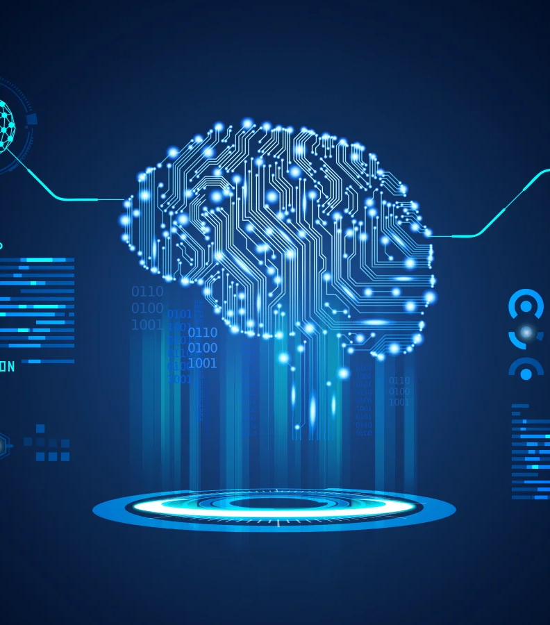
TEXT TO IMAGE CONVERTER
Name:
Aastha Prakash:500101844
Aditi Mupalla: 500105986

Slide 2
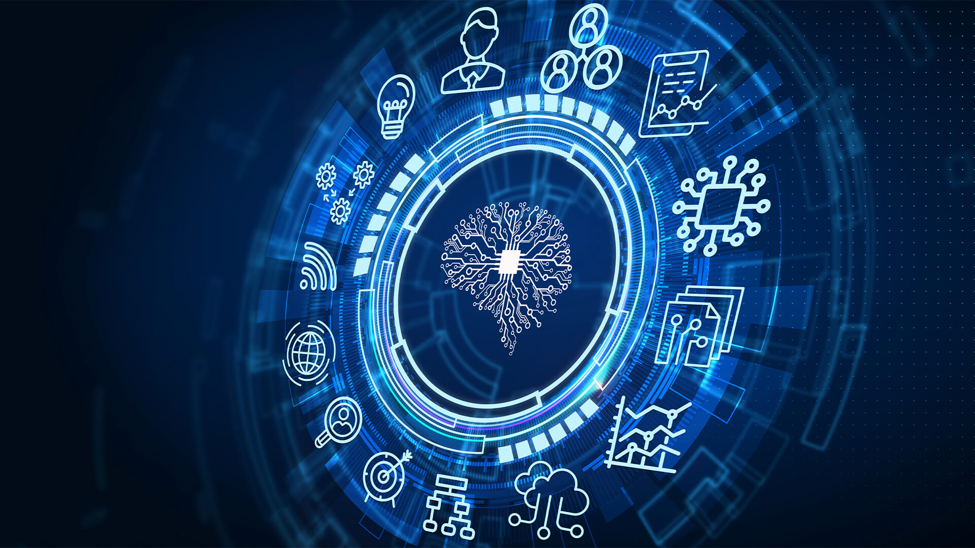
INTRODUCTION
A text-to-image converter is an advanced tool powered by artificial intelligence (AI) that transforms written descriptions into visual images.
This technology leverages deep learning models, enabling the system to interpret the text and generate corresponding visual representations, which closely align with the provided description.

Slide 3
Aim of the Project
The aim of this project is to develop a robust and efficient text-to-image converter that generates high-quality, realistic, and contextually accurate images based on textual descriptions.
This system seeks to bridge the gap between language understanding and visual generation by leveraging advanced deep learning techniques, such as natural language processing (NLP) and generative adversarial networks (GANs), to interpret and render text prompts into visually coherent images.
The ultimate goal is to enhance creative processes, support content generation, and offer novel applications in areas such as graphic design, advertising, and digital art.

Slide 4
Abstract
The text-to-image converter is a deep learning-based system that transforms textual descriptions into corresponding visual representations. By combining the strengths of NLP for understanding and processing text inputs and GANs for generating high-quality images, this system provides an end-to-end solution for translating text prompts into visual outputs.
The model is trained on diverse datasets to ensure that it can handle a wide range of descriptive inputs, producing images that are not only realistic but also contextually accurate. Applications of this technology include automated graphic design, content creation, and artistic exploration, where users can generate visual content based solely on written descriptions, enabling greater creativity and efficiency.

Slide 5
Stable Diffusion 3.5
Stable Diffusion is a latent text-to-image diffusion model capable of generating photo-realistic images given any text input
These models are highly customizable for their size, run on consumer hardware, and are free for both commercial and non-commercial use under the permissive Stability AI Community License.

